Slide 1

Digital Transformation, Value Chain, Socio-Technical System
(Week #2)
University Canada West (UCW)

Slide 2

Content
1- Introduction to Porter's Value Chain
2- The Shift to Digital Ecosystems
3- Components of Digital Ecosystems
4- Socio-Technical Systems (STS)
5- Case Studies
6- Implications for Businesses
7- Conclusion

Slide 3
Session Objectives
Grasp Porter's value chain model and its strategic importance.
Explore the evolution from linear value chains to digital ecosystems.
Analyze digital ecosystems' characteristics and components.
Evaluate socio-technical systems' role in digital ecosystems.
Review case studies of successful transitions to digital ecosystems.
Discuss digital ecosystems' impact on value creation and competition.

Slide 4
1- Introduction to Porter's Value Chain
1-1- Overview of Porter's Value Chain Analysis
Michael Porter's Value Chain Analysis is a strategic framework designed to improve business operations by breaking down the process into primary and support activities.
Introduced in his 1985 book, it helps companies identify areas of value creation and potential competitive advantages.

Slide 5
1- Introduction to Porter's Value Chain
1-2- The five primary activities:
Inbound Logistics: Handling and storing incoming materials.
Operations: Transforming inputs into the final product.
Outbound Logistics: Distributing the product to customers.
Marketing and Sales: Promoting and selling the product.
Service: Providing after-sale support and services.

Slide 6
1- Introduction to Porter's Value Chain
1-3- The four support activities:
Firm Infrastructure: Organizational structure and management.
Human Resource Management: Employee recruitment, training, and development.
Technology Development: Innovations in product and process.
Procurement: Acquiring inputs needed for production.

Slide 7
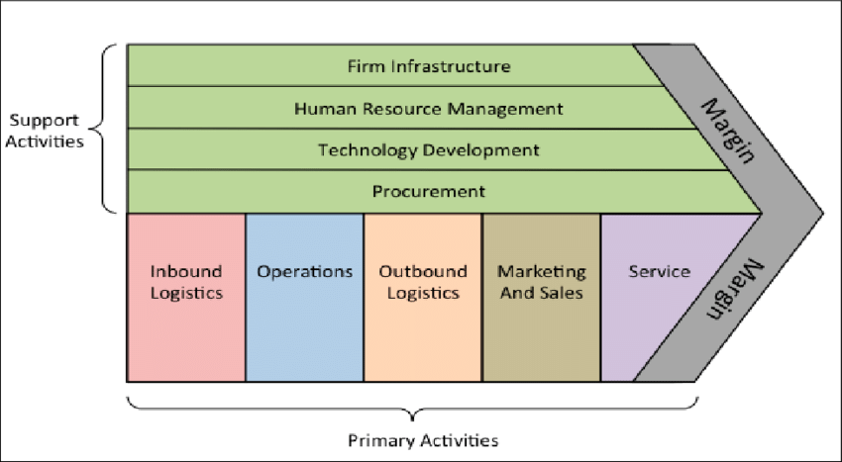
1- Introduction to Porter's Value Chain

Slide 8
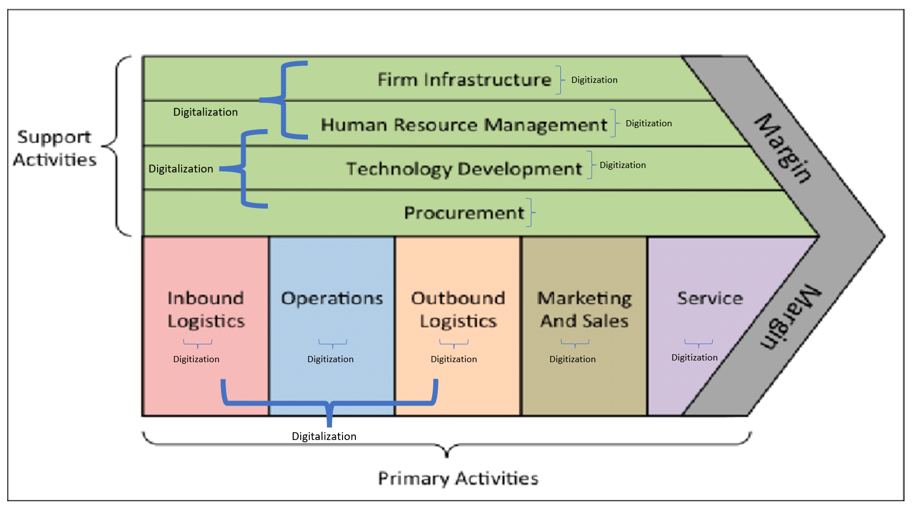
1- Introduction to Porter's Value Chain

Slide 9
1- Introduction to Porter's Value Chain
1-4- Application of the Value Chain in strategic analysis
The value chain framework helps businesses analyze their activities to find inefficiencies, reduce costs, and improve customer value.
By examining how each activity contributes to overall value creation, companies can identify competitive advantages and make strategic improvements

Slide 10
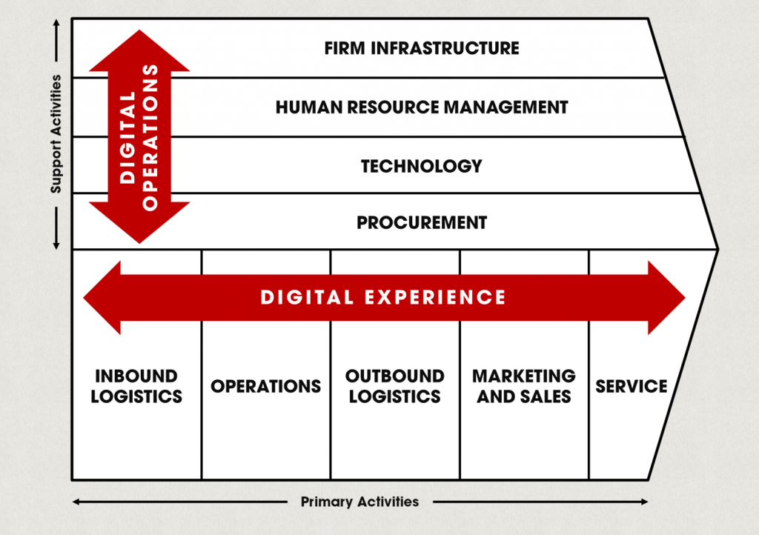
1- Introduction to Porter's Value Chain
1-5- Integration into Value Chain

Slide 11
2- The Shift to Digital Ecosystems
2-1- Definition and characteristics of digital ecosystems
Definition: The move from traditional value chains to digital ecosystems marks a significant change in business strategy and value creation. Unlike linear value chains, digital ecosystems are dynamic networks that connect companies, consumers, and technology providers to co-create value.

Slide 12
2- The Shift to Digital Ecosystems
2-1- Definition and characteristics of digital ecosystems
Key Features of Digital Ecosystems:
Interconnectivity: Links between various entities enhance value flow.
Scalability: Easier expansion at lower costs.
Data-centricity: Data drives insights and innovation.
Openness: Easy integration of third-party services encourages innovation.

Slide 13
2- The Shift to Digital Ecosystems
2-2- The role of technology in transforming value chains
Technology fundamentally reshapes value chains into digital ecosystems through:
Connectivity: IoT and cloud computing streamline operations.
Data Analytics: Insights and automation powered by big data and AI.
Platforms: Digital platforms connect users, amplifying value with network growth.
Customer Engagement: Mobile tech and VR/AR offer personalized experiences.
Security: Cybersecurity ensures data protection and trust.

Slide 14
2- The Shift to Digital Ecosystems
2-3- From linear processes to interconnected platforms
Traditional value chains add value in a linear, step-by-step process. Digital ecosystems, however, are dynamic and non-linear, involving complex interactions among various participants.
This shift has several implications:
Value Creation: Network effects increase value as more participants join.
Customer Focus: Personalization and enhanced experiences are central.
Innovation: Collaboration within the ecosystem spurs new solutions.

Slide 15
2- The Shift to Digital Ecosystems
2-4- Examples of digital ecosystems
Amazon: Evolved from an online bookstore to a vast digital ecosystem.
Apple: Integrates hardware, software, and services for a seamless user experience.
Alibaba: Expands beyond e-commerce to include payments, cloud computing, and more.

Slide 16
3- Components of Digital Ecosystems
Digital ecosystems are built on several key components that work together to create a seamless, interconnected environment:
3-1- Core Platforms
Infrastructure Platforms: Essential services like cloud computing and data storage.
Marketplace Platforms: Connect buyers and sellers (e.g., Amazon, eBay).
Service Platforms: Provide specific services (e.g., PayPal for payments, Netflix for streaming).

Slide 17
3- Components of Digital Ecosystems
3-2- The network of participants
Users: End consumers of the ecosystem.
Providers: Offer products or services within the ecosystem.
Developers: Create apps or services that enhance the ecosystem.
Partners: Contribute through strategic collaborations or integrations.

Slide 18
3- Components of Digital Ecosystems
3-3- Data and analytics as the backbone of digital ecosystems
Data: Collected from user interactions, transactions, and service usage.
Analytics: Tools that analyze data for insights, optimization, and decision-making.

Slide 19
3- Components of Digital Ecosystems
3-4- The importance of APIs and SDKs in ecosystem integration
APIs (Application Programming Interfaces): Allow software applications to communicate.
SDKs (Software Development Kits): Help developers build compatible applications or services.

Slide 20
3- Components of Digital Ecosystems
3-5- Governance and Standards
Governance Models: Rules and policies for ecosystem participation and data sharing.
Standards and Protocols: Ensure compatibility and smooth integration across the ecosystem.

Slide 21
4- Socio-Technical Systems (STS)
4-1- Definition and Key Concepts
Definition: A framework highlighting the interplay between an organization's social elements (people, culture) and technical elements (technology, processes).
Social Systems: Encompass the organizational structure, culture, and employee dynamics.
Technical Systems: Include the technologies and processes that support business operations.

Slide 22
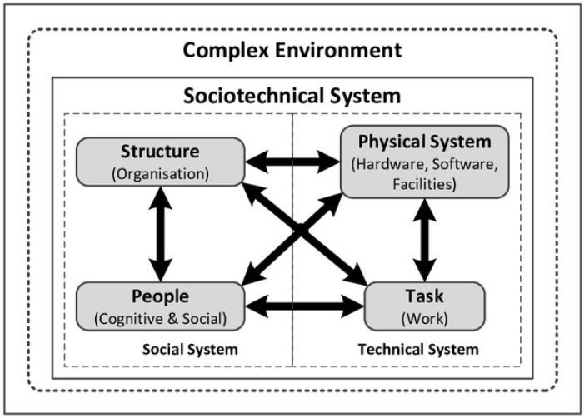
4- Socio-Technical Systems (STS)

Slide 23
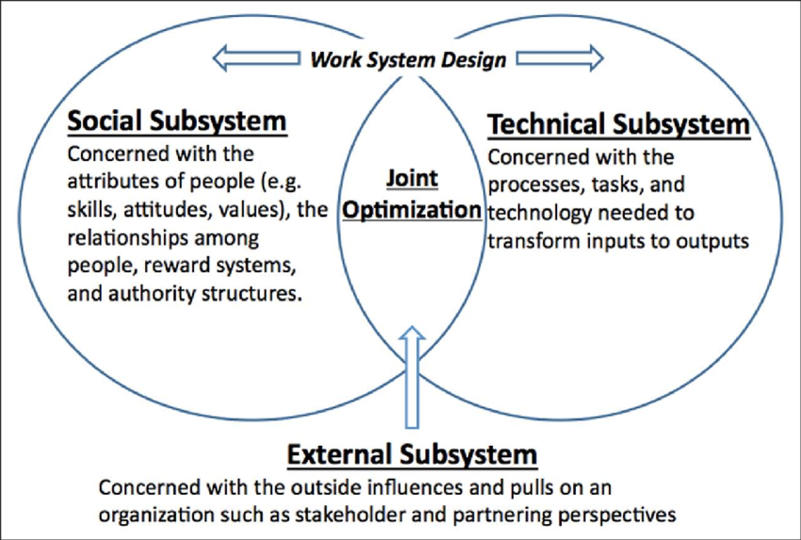
4- Socio-Technical Systems (STS)
4-2- Jointed Optimization

Slide 24
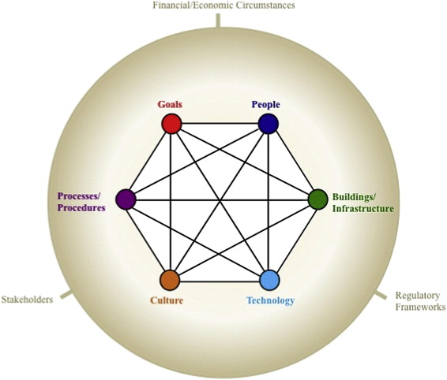
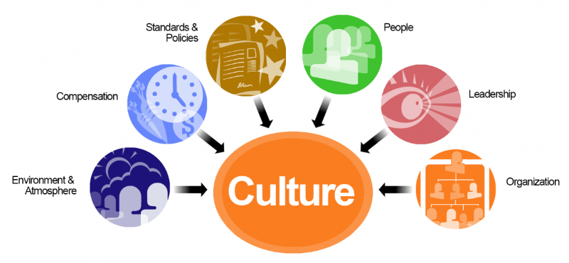
4- Socio-Technical Systems (STS)
4-3- Importance of STS

Slide 25
4- Socio-Technical Systems (STS)
4-4- Relevance to Digital Ecosystems
Harmony Between Technology and People: Ensures technology supports and enhances human work, maintaining organizational culture during digital transitions.
Promotes Collaboration and Innovation: By balancing social and technical aspects, organizations can foster environments ripe for innovation and adaptable to change.

Slide 26
4- Socio-Technical Systems (STS)
4-4- Relevance to Digital Ecosystems
Participatory Design: Engage employees in technology design and implementation to align technical systems with social needs.
Continuous Learning: Support employee adaptation to new technologies through training and development.
Change Management: Use change management to ease the integration of new technologies and maintain employee engagement.

Slide 27

4- Socio-Technical Systems (STS)
4-5- Theory in Practice

Slide 28
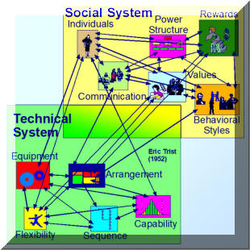
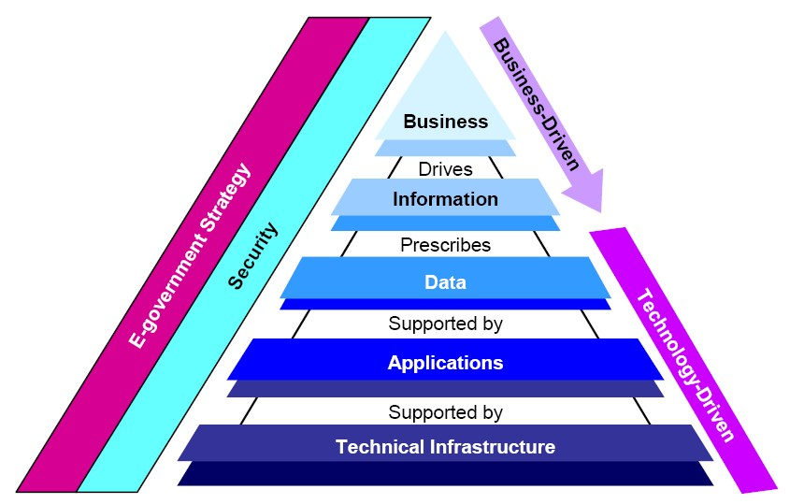
4- Socio-Technical Systems (STS)
4-6- Your Role

Slide 29
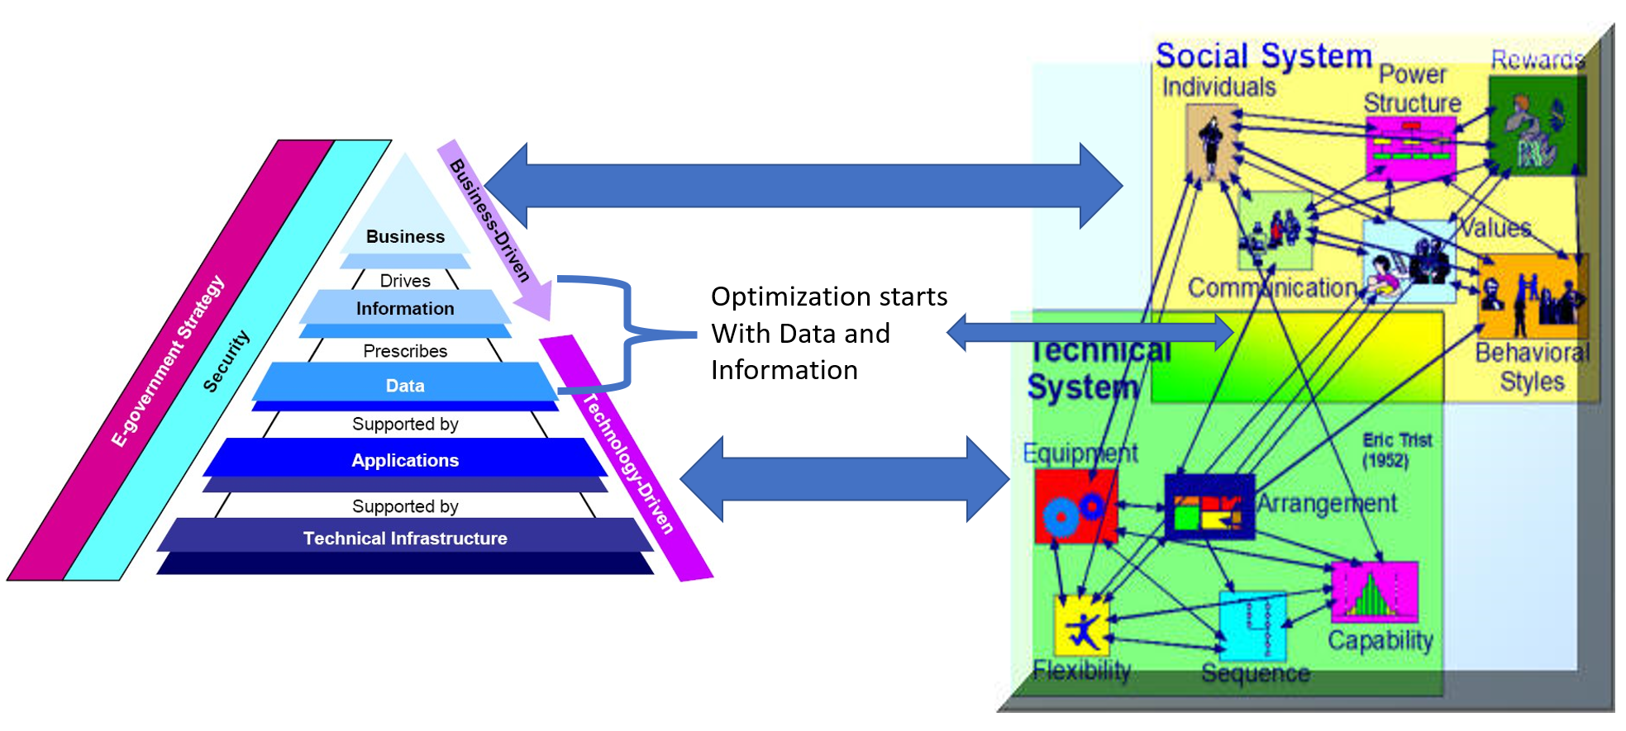
4- Socio-Technical Systems (STS)

Slide 30

4- Socio-Technical Systems (STS)

Slide 31
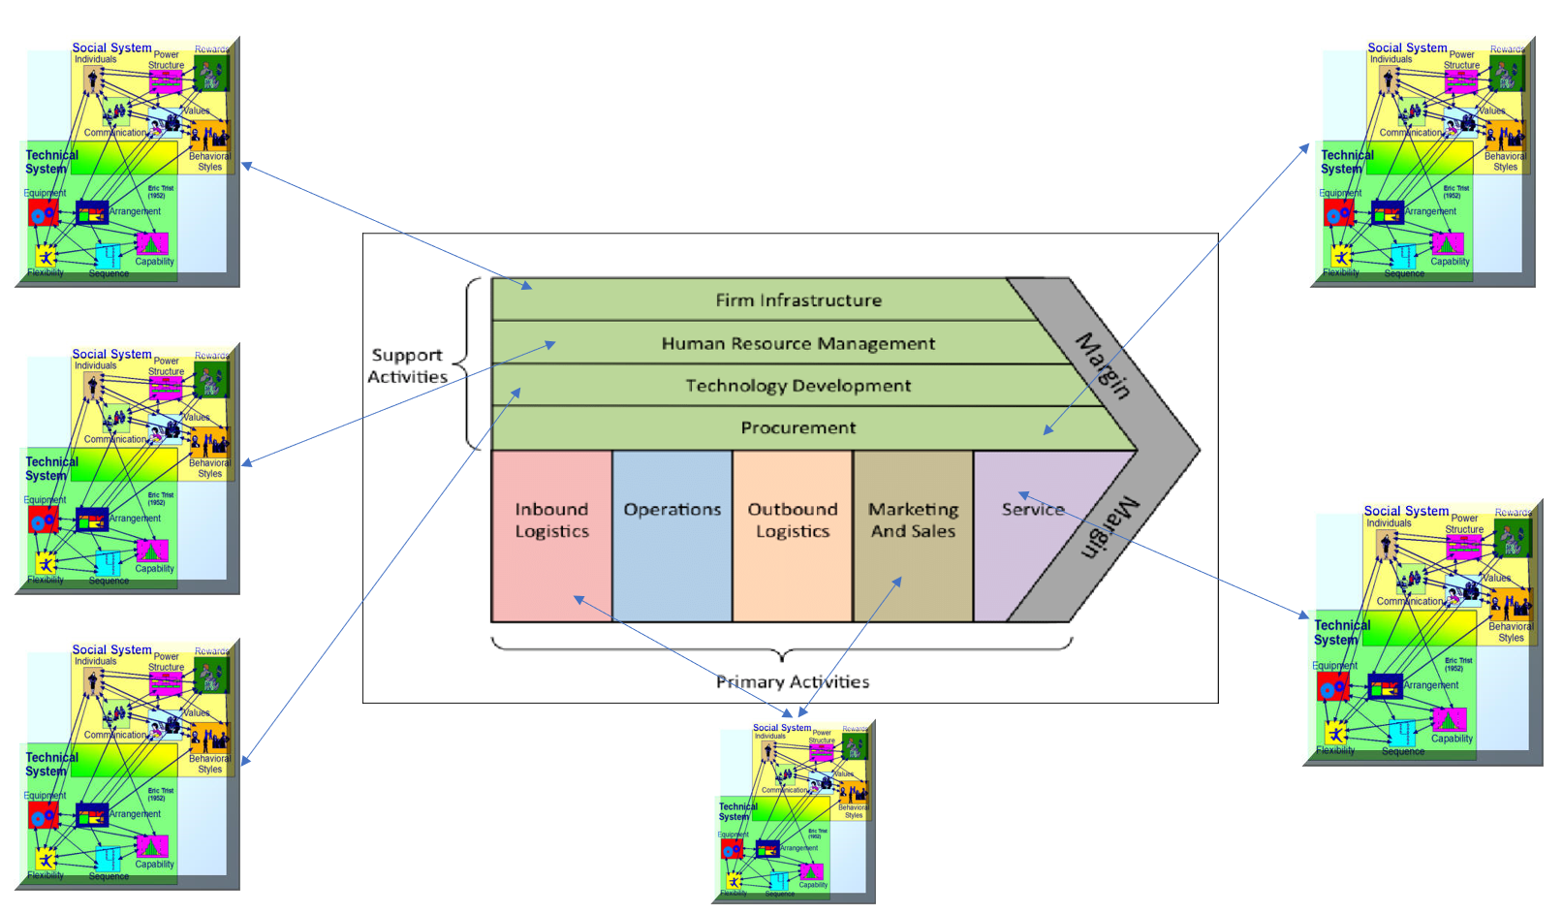
4- Socio-Technical Systems (STS)

Slide 32
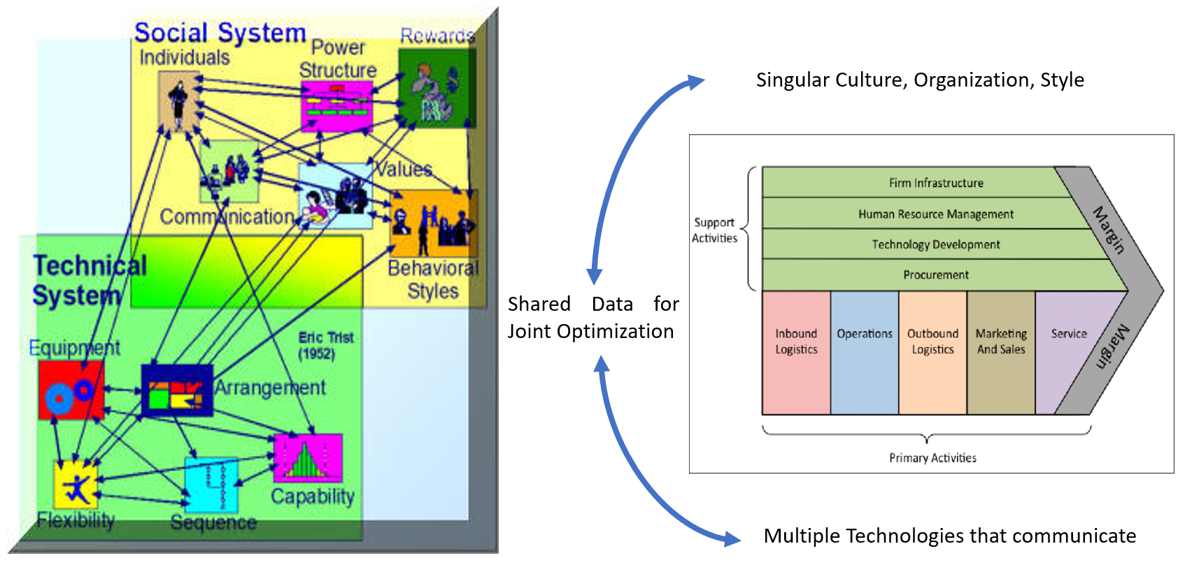
4- Socio-Technical Systems (STS)

Slide 33
5- Case Studies
5-1- Amazon: Digital Ecosystem Evolution
Evolution: From an online bookstore to a comprehensive digital ecosystem.
Key Moves: Introduced AWS, Prime, and Echo/Alexa, blending technology with customer engagement.
Impact: Achieved global leadership by integrating technical infrastructure with personalized customer experiences.

Slide 34
5- Case Studies
5-2- Apple: Seamless Integration
Evolution: Transitioned to an integrated ecosystem with hardware, software, and services..
Key Moves: Focused on seamless device connectivity and expanded services like Apple Music.
Impact: Gained high customer loyalty through quality and a unified socio-technical user experience.

Slide 35
5- Case Studies
5-3- Alibaba: Leveraging Data and Community
Evolution: Grew from a B2B platform to a vast e-commerce and cloud ecosystem.
Key Moves: Developed Taobao, Tmall, and Alipay, using big data for insights and personalization.
Impact: Transformed commerce in China, balancing technical innovation with a strong user community.

Slide 36
6- Implications for Businesses
6-1- Rethinking Value Creation and Capture
Focus on customer experiences and personalization.
Innovate continuously to meet evolving consumer demands.
Explore new digital revenue streams.
6-2- Strategic Considerations
Decide whether to join, build, or compete with digital ecosystems.
Develop a platform strategy for scaling and market access.
Implement a robust data strategy for insights and optimization.

Slide 37
6- Implications for Businesses
6-3- Competitive Advantage of Ecosystem Orchestration
Gain control and influence over the ecosystem.
Benefit from network effects as the ecosystem grows.
Access valuable data across the ecosystem for strategic decisions.
6-4- Challenges and Risks
Manage the complexity of technology integration and partnerships.
Ensure data security and privacy in a data-centric environment.
Mitigate dependence on platforms to avoid vulnerability.

Slide 38
7- Conclusion
The shift from Porter's value chains to digital ecosystems highlights a critical evolution in business strategy, requiring adaptation, innovation, and socio-technical integration.
Success hinges on customer focus, technological leverage, risk management, and maintaining agility and strategic ecosystem involvement.

Slide 39
Main References
1- Leading Digital: Turning Technology into Business Transformation by George Westerman, Didier Bonnet, and Andrew McAfee
2- Digital Transformation: Survive and Thrive in an Era of Mass Extinction by Thomas M. Siebel
3- Building Digital Culture: A Practical Guide to Successful Digital Transformation by Daniel Rowles and Thomas Brown

Slide 40

Thank you for your participation!
Your journey in learning and exploration doesn't end here.
Feel free to contact me if you have any questions or feedback.
Dr. Davood Wadi
Full-time Faculty
University Canada West (UCW)
Vancouver, BC
davood.wadi@myucwest.ca

